Slide 1
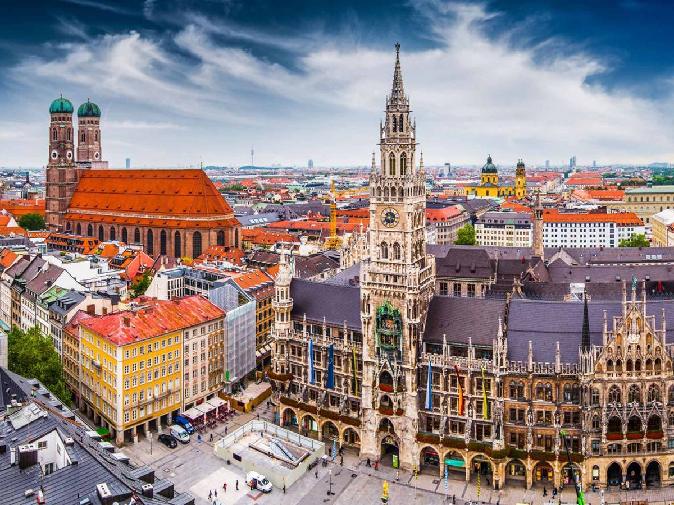
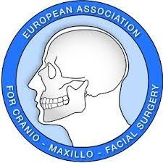
Presentation at the EACMFS Council
Fellowship Training In Munich, Germany
1 October 2023 to September 24, 2024
Dr. Chaim Ohayon Senior Consultant, Oral & Maxillofacial Surgery Department Rambam Health Care Campus, Haifa, Israel
EACMFS Leibinger award Prize 2024
Athens , October 2025

Slide 2
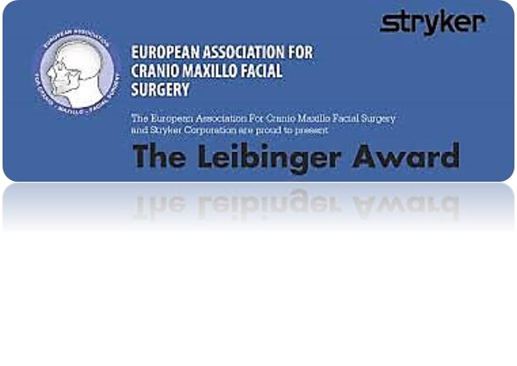
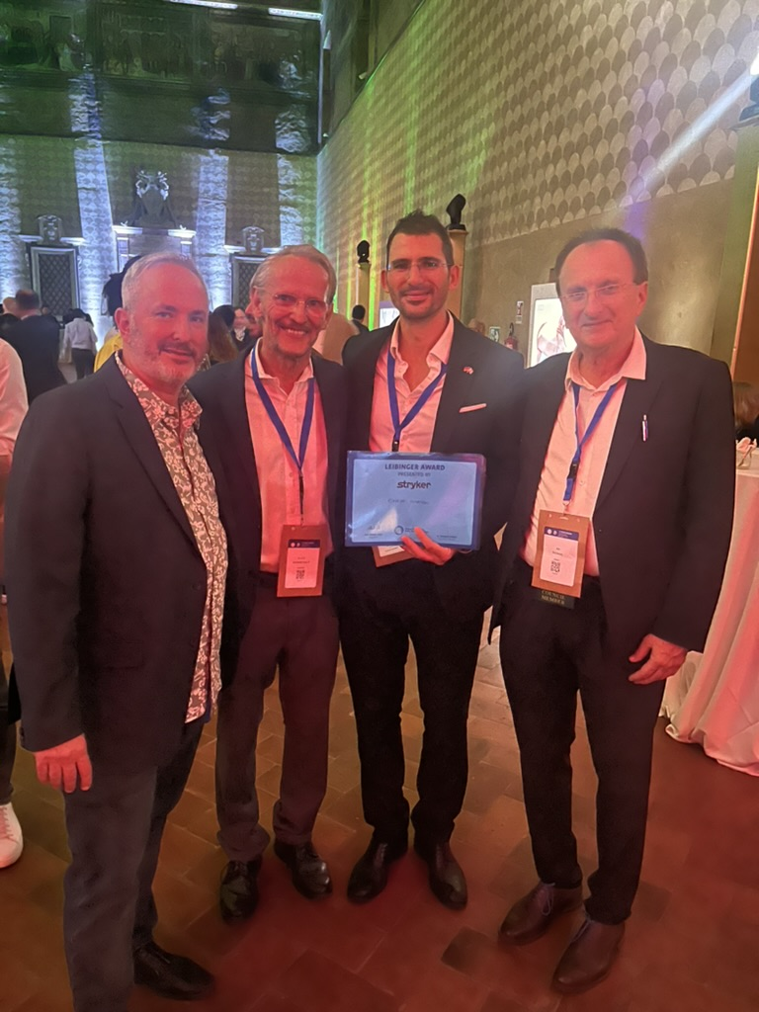
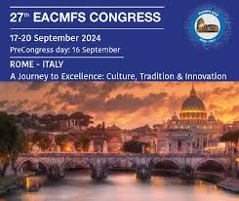
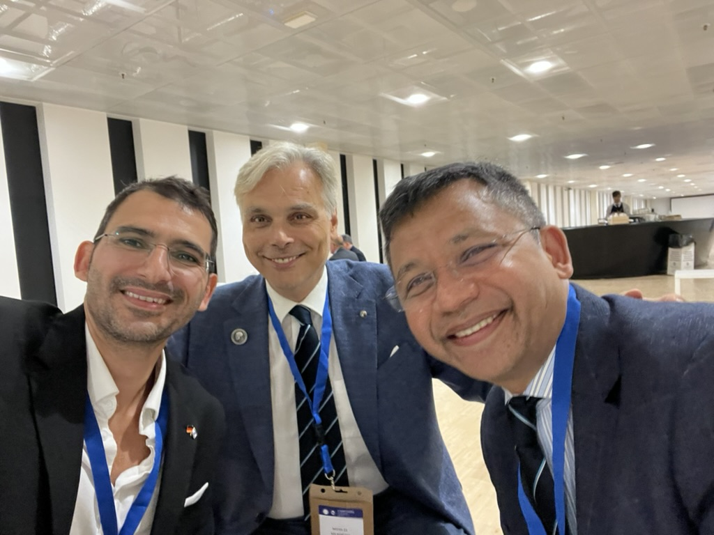
Leibinger Award

Slide 3
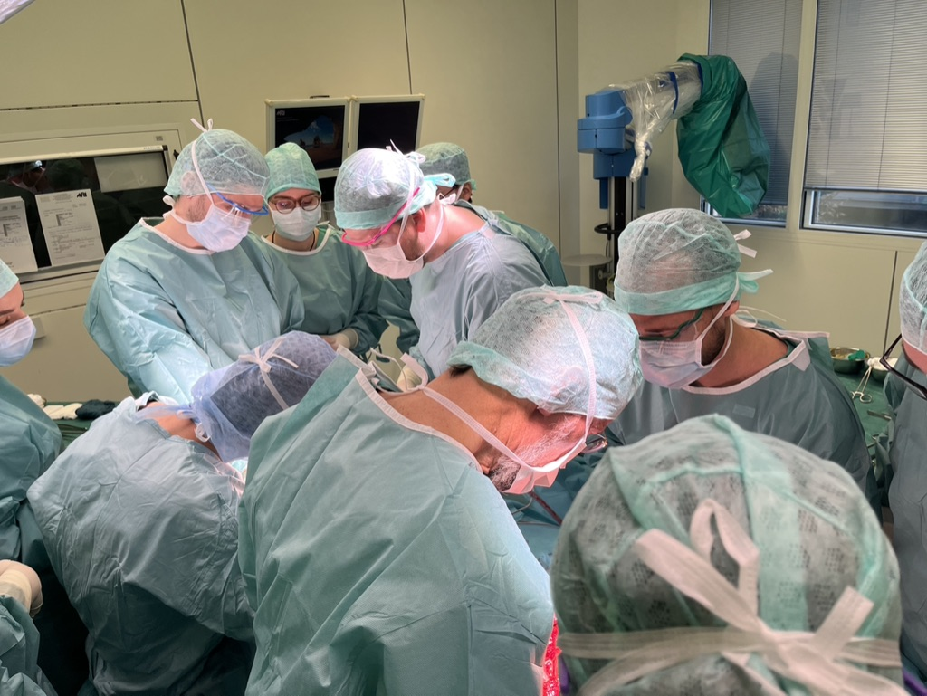
Why a Fellowship Abroad?
European high-volume centers in microvascular reconstruction offer unique exposure to advanced techniques and true multidisciplinary teamwork. Training in this environment allowed me to refine my skills and prepare to develop a comprehensive microvascular service in Northern Israel.

Slide 4
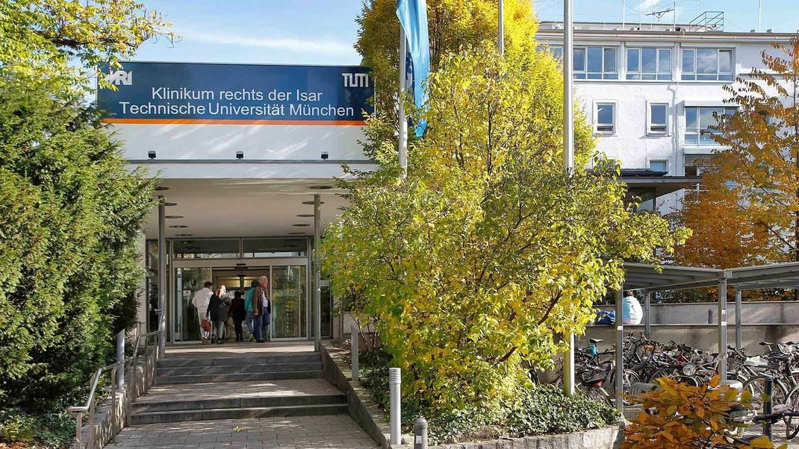
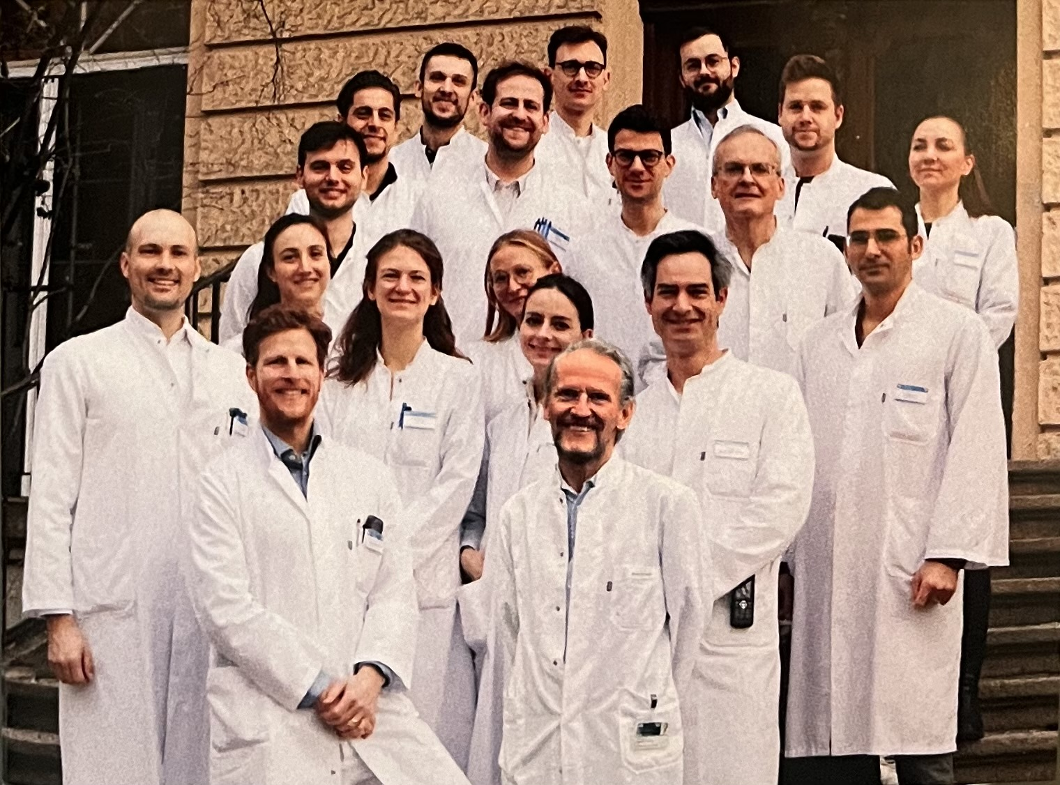
Why Klinikum rechts der Isar?
The department is one of Europe’s leading hubs for head & neck oncology and microvascular reconstruction. Under the guidance of Prof. Wolff and his great team , it combines exceptional surgical volume with innovation such as double free flaps and complex salvage cases. Its international reputation makes it a unique environment for advanced training and collaboration.

Slide 5
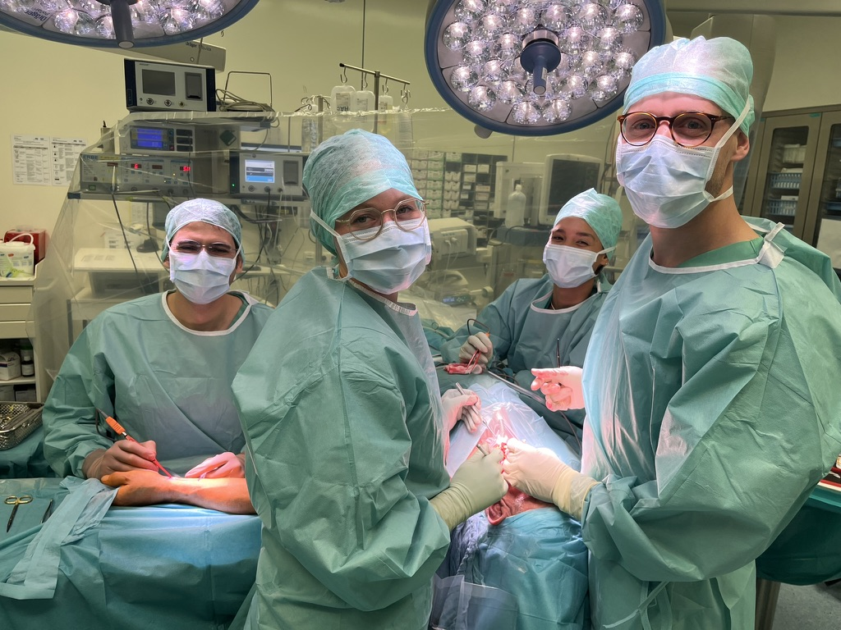
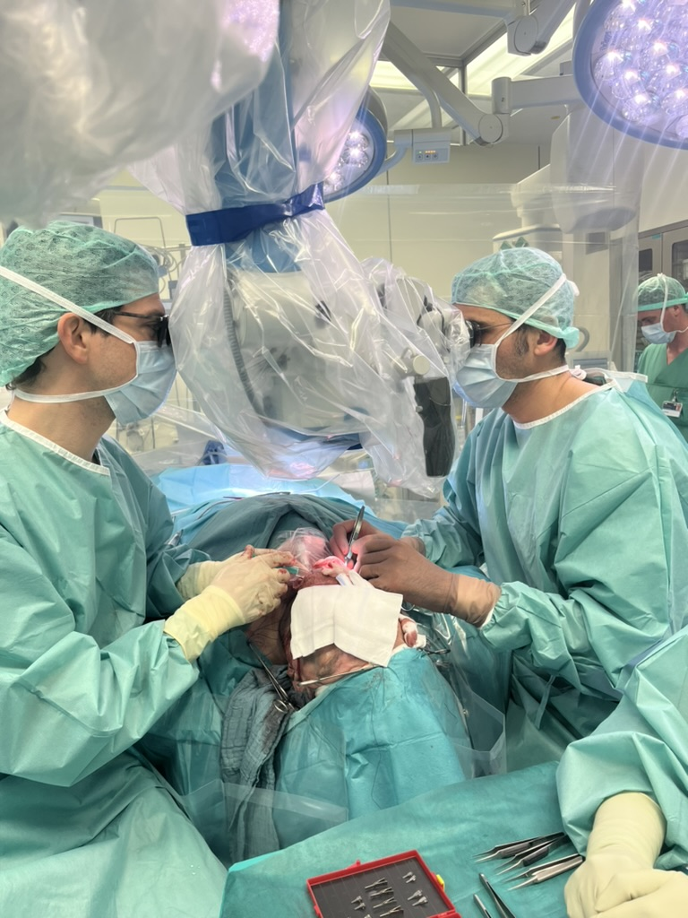
The Department’s Story
The department is built on a culture of teamwork, excellence, and continuous learning. Its highly skilled surgeons work closely together, sharing knowledge and expertise on every case. This collaborative spirit creates an outstanding environment for advanced training in microvascular reconstruction.

Slide 6
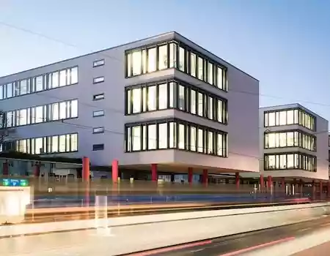
The Department in Numbers
25 inpatient beds dedicated to Oral & Maxillofacial Surgery
~10 operating rooms weekly
4 microvascular surgery days per week, including:
Head & neck oncology
Benign tumors
Secondary reconstructions
Additional expertise: facial trauma, orthognathic surgery, cleft lip & palate

Slide 7
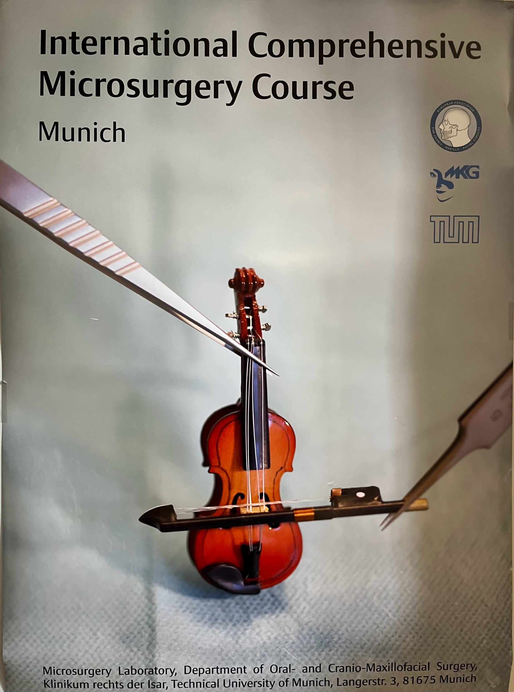
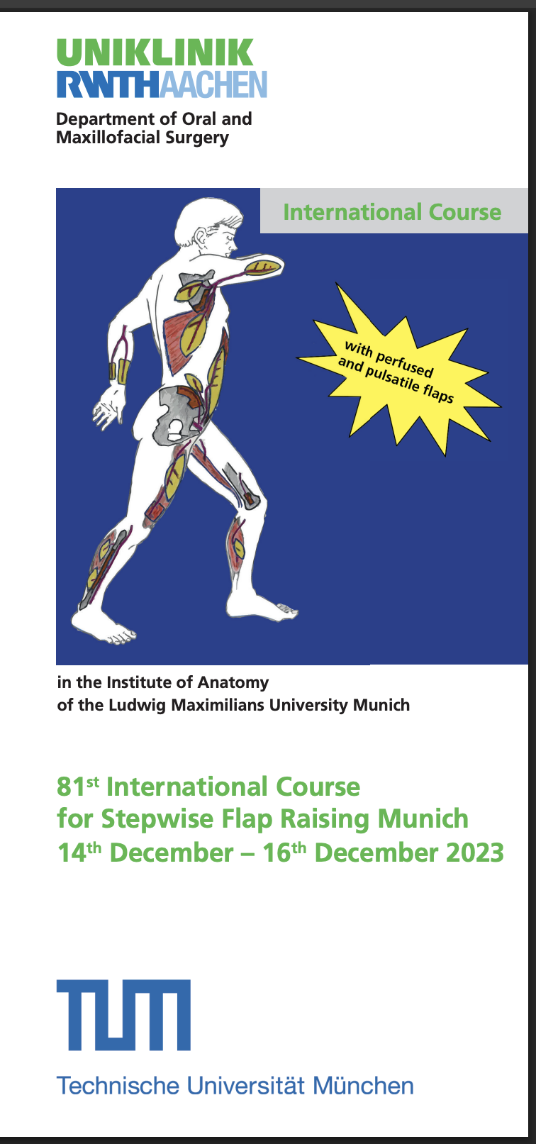
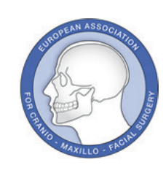
My Fellowship Experience
Educational Courses
I participated in two advanced courses led by the department and Prof. Wolff, which provided structured teaching and further enriched my microvascular training.

Slide 8
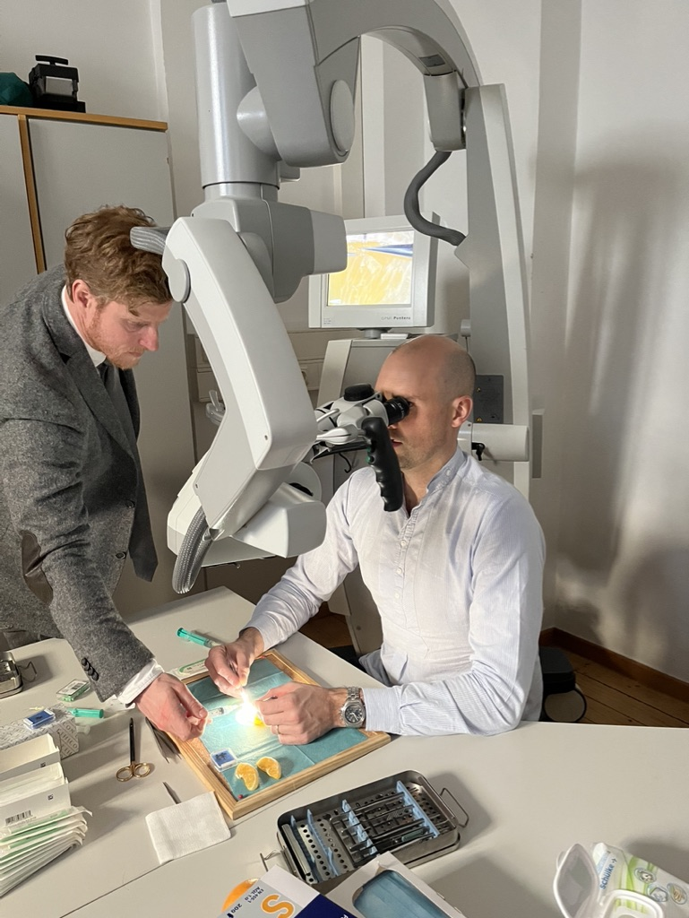
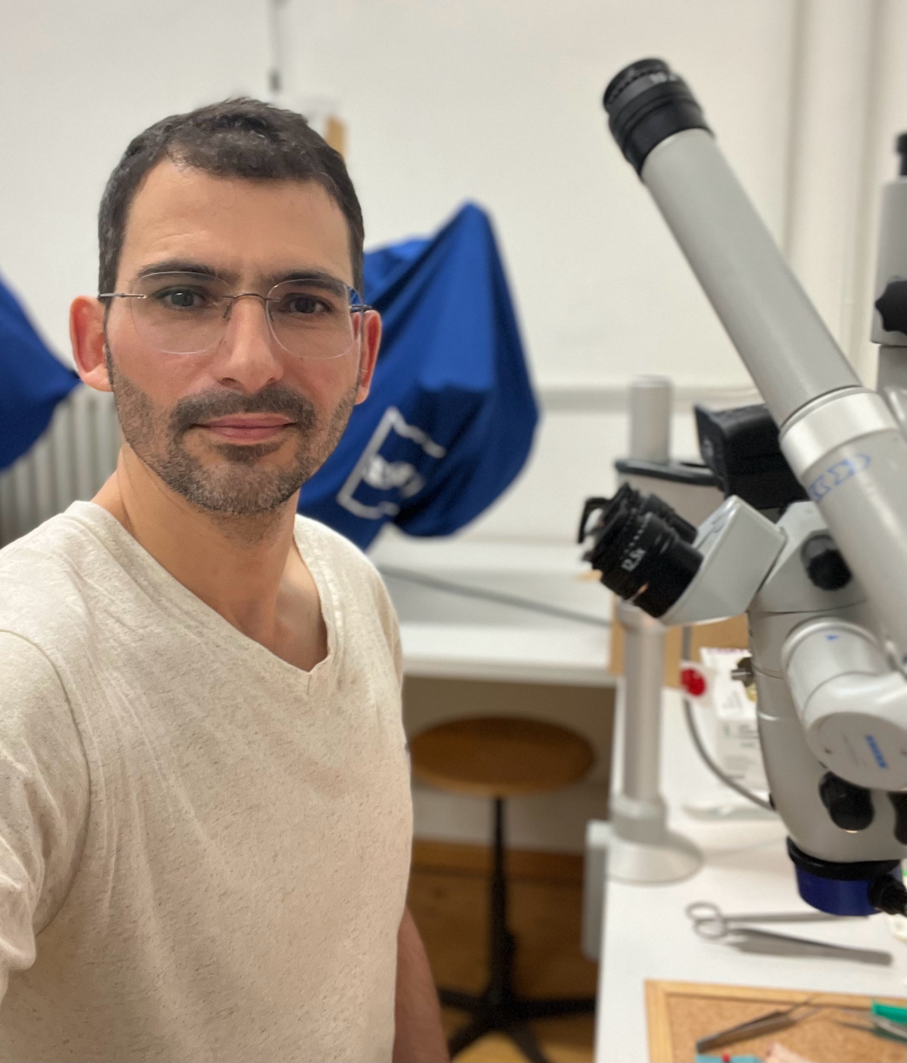
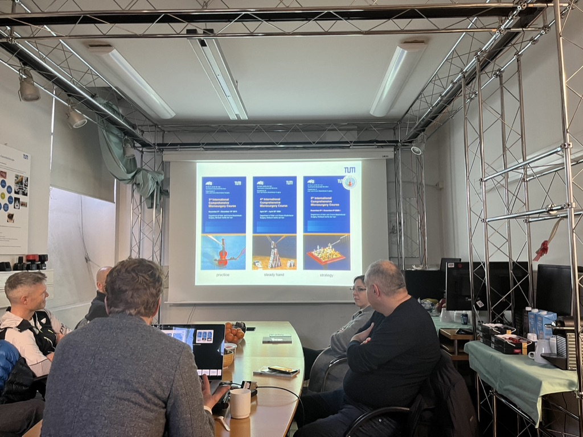
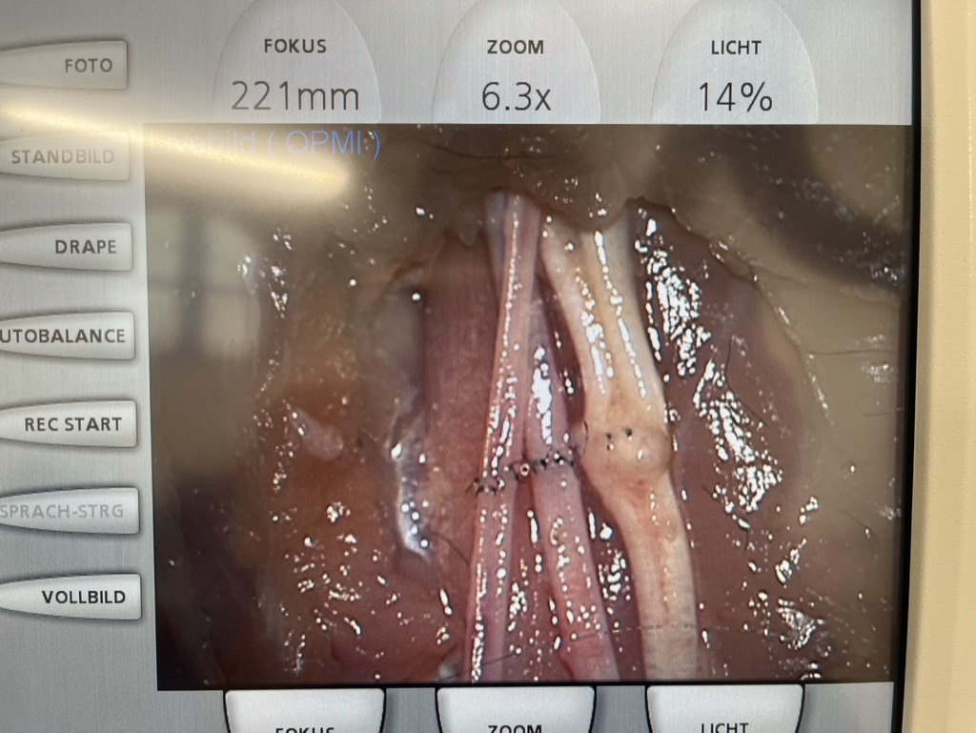
Internationl Comprehensive Microsurgery Course

Slide 9
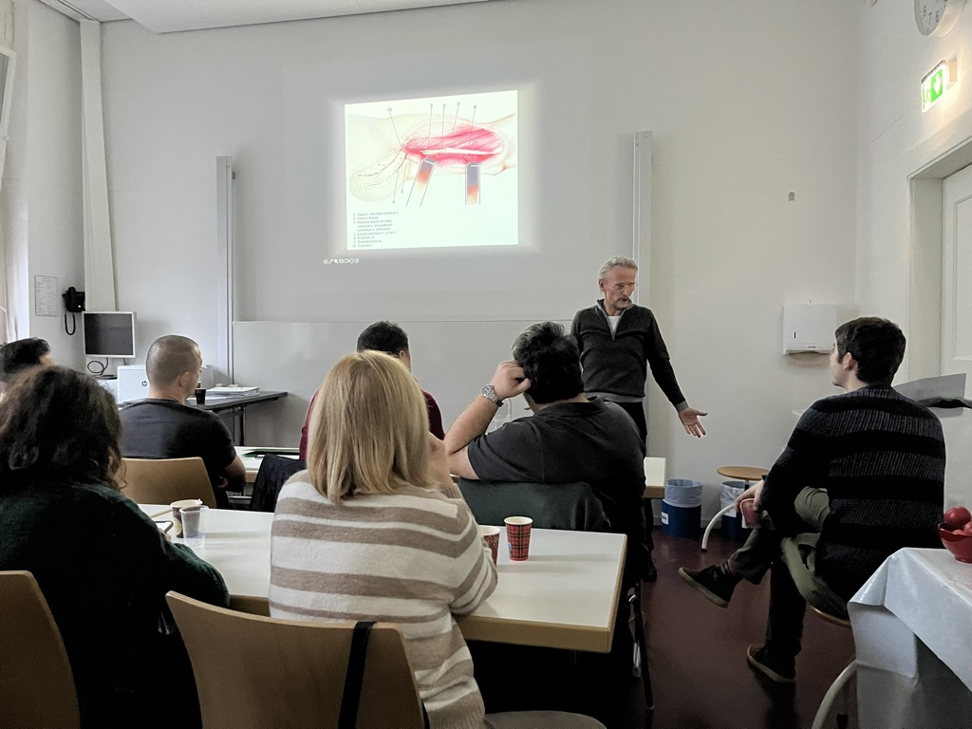
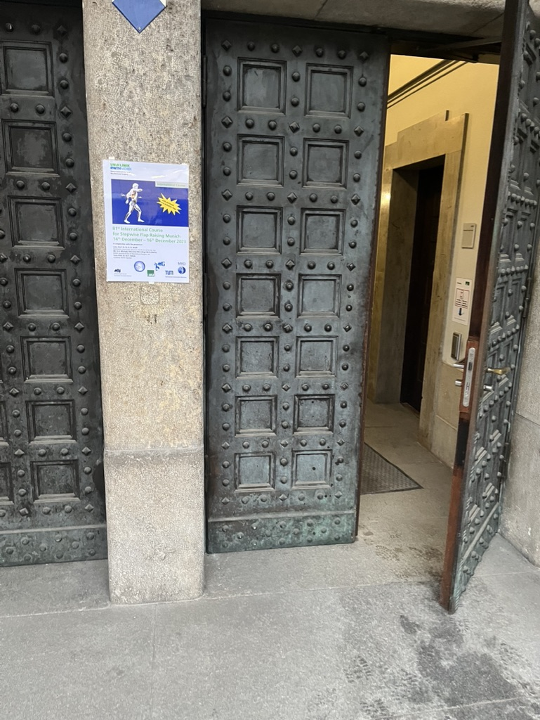
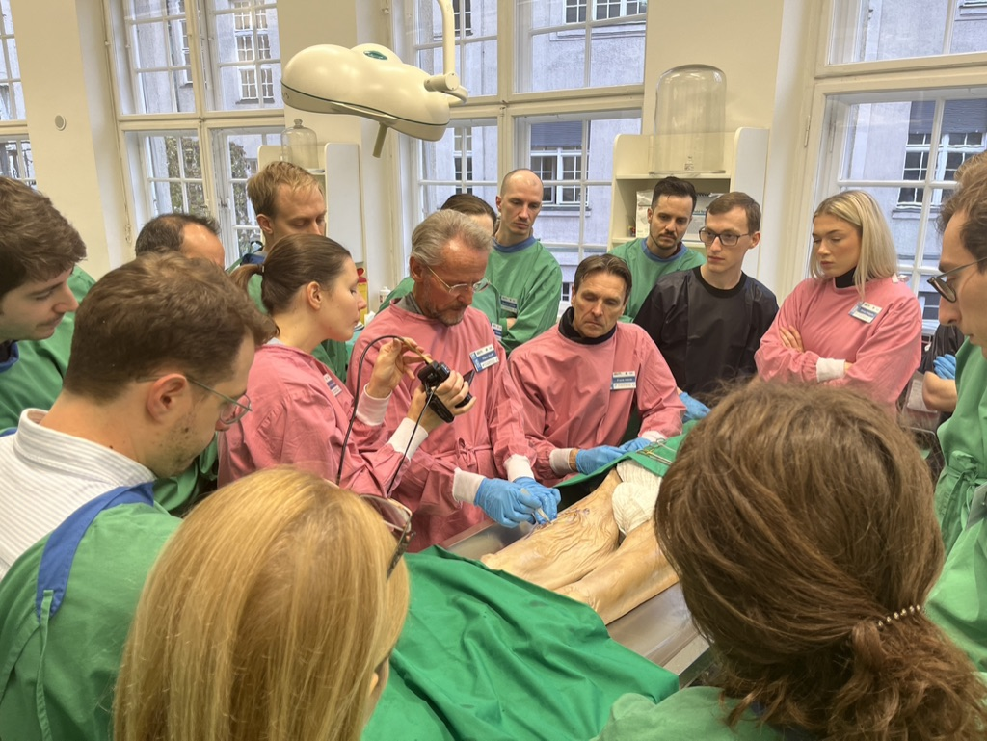
81st International Course for Stepwise Flap Raising

Slide 10
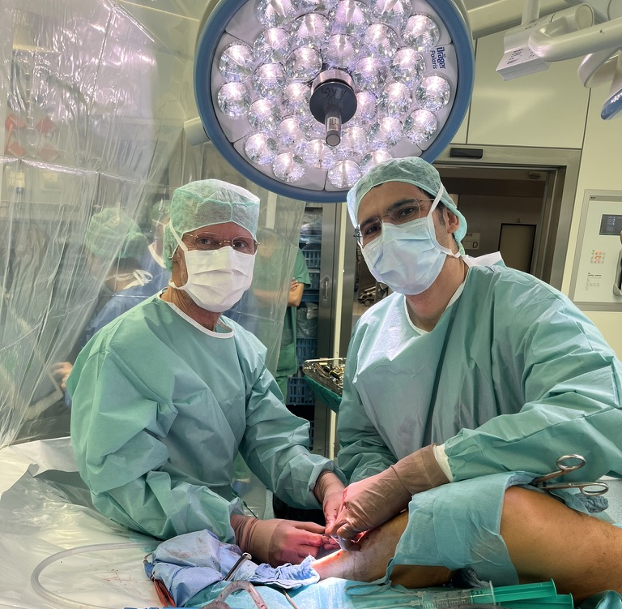
My Fellowship Experience
Clinical Experience
During my fellowship year in Munich, I was fully integrated into the surgical team. I gained hands-on experience in over 120 microvascular free flap surgeries, including complex salvage procedures and innovative reconstructive techniques.

Slide 11
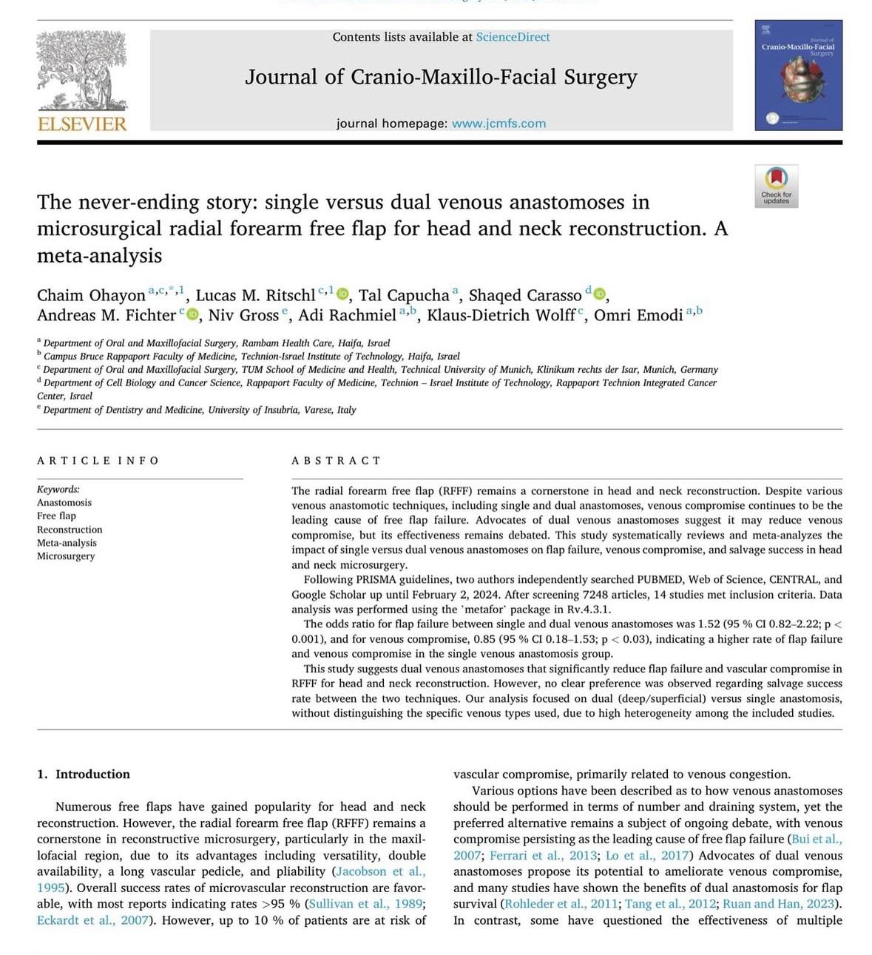
My Fellowship Experience
Research & Publications
Alongside my clinical work, I contributed to research project and international publications. This strengthened both my academic profile and my collaboration with European colleagues.

Slide 12
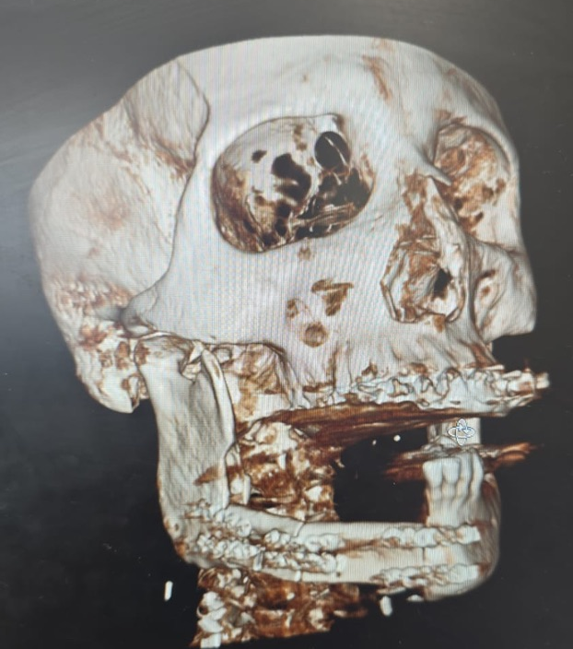
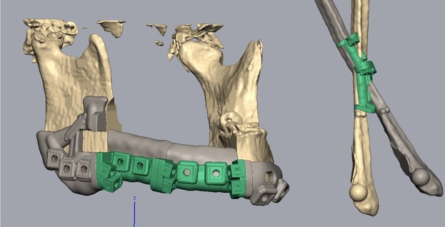
From Munich to Haifa: skills gained, impact delivered
Munich gave me advanced microvascular skills and the spirit of teamwork.
Back in Haifa, I am already applying this knowledge in dozens of reconstructions and laying the foundation for a regional head & neck oncology service.
Notes:
תמונות סיטי או משנו של מקרים או שחזורים יפים ..

Slide 13
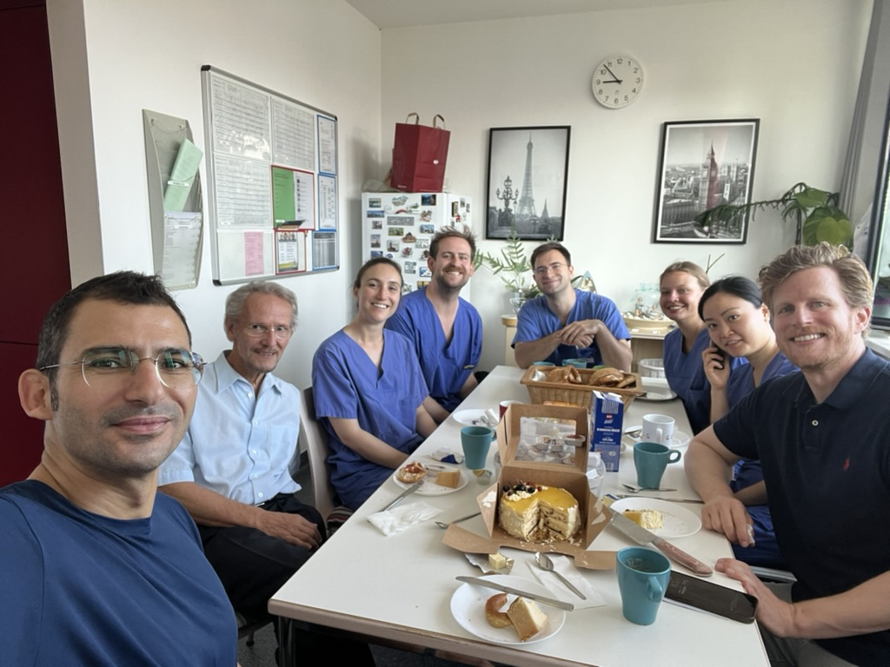
תודה רבה Danke Thank you

